Slide 1


One IT | Revamp of 3 applications in the Organization’s Intranet Portal
Devansh Bindlish
IT
USICT, Dwarka
Dept. of Information Technology

Slide 2
Contents
Introduction: Current Setup and Challenges
Introduction : One IT
One IT- Phase 2 and Phase 3
One IT: Advantages
Applications
      Request for Transportation
      Condition Record Update
      Trident Letter Entry System
Key learnings and Takeaways

Slide 3

Introduction
Current Setup
Challenges
User confusion as certain applications open directly while certain ask for user login
Poor application standardization
SSO not completely enabled for all applications | multiple login pages
Poor User Experience and Design I non standardized interfaces
User confusion due to poor standardization followed
Poor user experience leads to lower utilization of applications
Presence of unused or obsolete applications and documents | clean up incomplete
Old applications eat into server space
Old users could get confused and would continue using the unused/obsolete applications

Slide 4
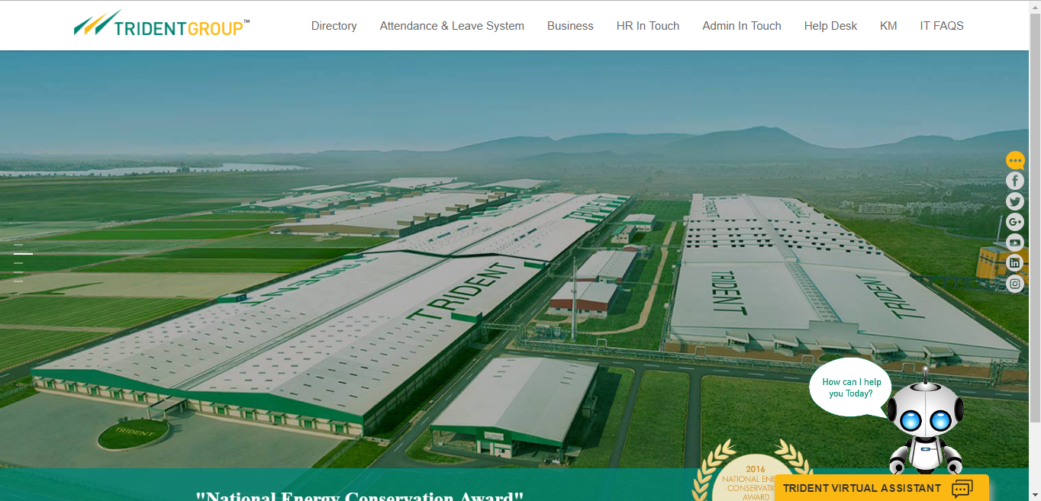
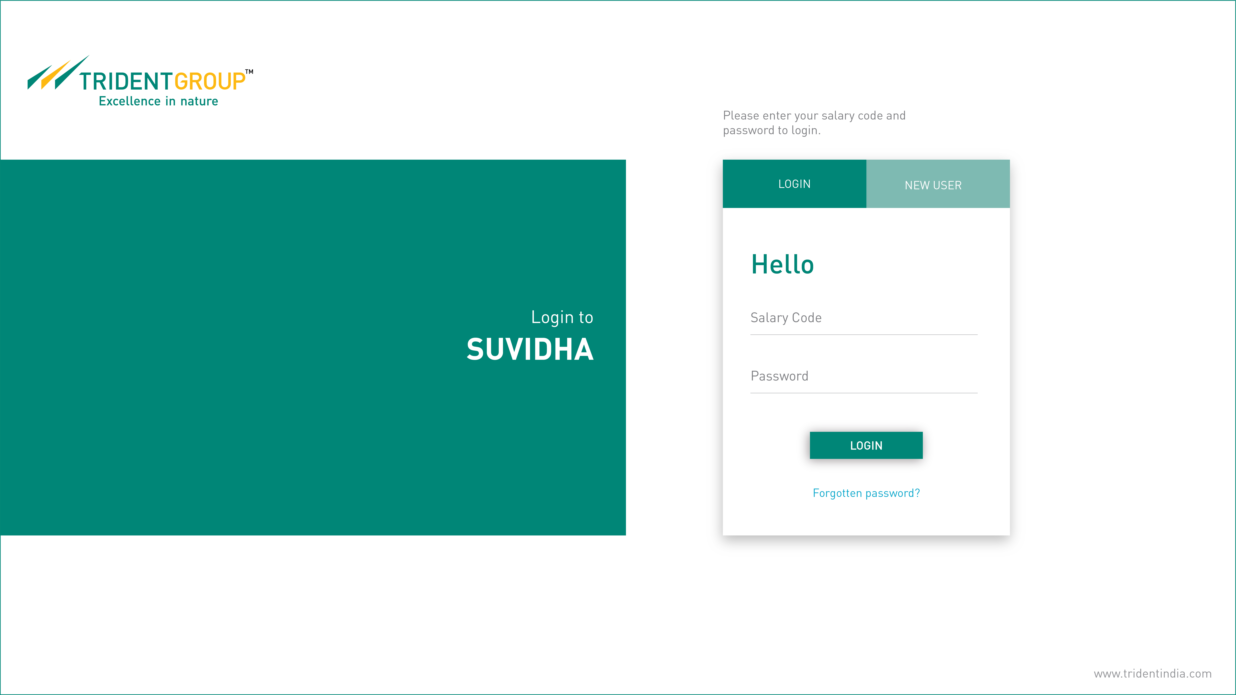
Introduction: One IT
One IT: A project that aims to plug the before mentioned challenges by providing the users a better standardized and secure employee portal for enhanced user experience through the link: http://www.suvidha.com.
Covered under 3 phases with a target of closing ~ 50 applications under the Suvidha ambit

Slide 5
One IT- Phase 2 and Phase 3
Phase 1 covered a total of 9 applications
Phase 2 targets 16 applications while the rest would be covered in Phase 3 and later stages

Slide 6
One IT- Advantages
The main advantages of the project One-IT are :
RSO - Login once and access all applications.
Standardized interfaces – provides better UX.
Clean Up - Clear all unwanted pages and applications to make the site reach its optimum speed and efficiency.
Easy Access – Enhance functionalities and make them easily accessible.

Slide 7
Applications
Applications Dealt With:-
Request for Transportation
  Enhancement of user experience
  Added new features
  Back end integration
Condition Record Update
  Improvement in user experience
Trident Letter
  Improvement in user experience

Slide 8
Applications
Application 1: Request for transportation

Slide 9
Existing working of Transportation Application
User Enters Transportation Portal
Employee fills the details
and clicks on Save
HOD
Approval
YES
NO
Goes
to Admin
Reject
Approve
Message is manually
generated
User gets the message

Slide 10
Proposed working of Transportation Application
User Enters Transportation Portal
Employee fills the details
and clicks on Save
Additional features added
on the home page
HOD
Approval
YES
NO
Current Status
Today’s Status
Goes
to Admin
Reject
Approve
Worked on these
Message is automatically
generated
User gets the message
Added New Features

Slide 11
As- IS state
The driver details are now sent to users via SMS manually with no prior system-based intimation via email.
The employee can neither check and nor can get update on their request whether it is pending, approved or rejected.
In the present scenario there is no check on the employee whether they are going to the place as per their request or not.

Slide 12

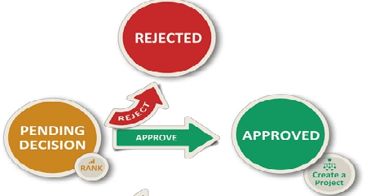
To-Be state
System based notification of driver and cab details via email to user, along with manual SMS (to be automated later).
There would be constant update to the employee about the request so that they can plan accordingly.
The employee can now also check their request status anytime using the feature of Current Status.
There would be a constant check on the employee by the guard as to whether they are going to the place as per the made request using Today’s Status feature.

Slide 13
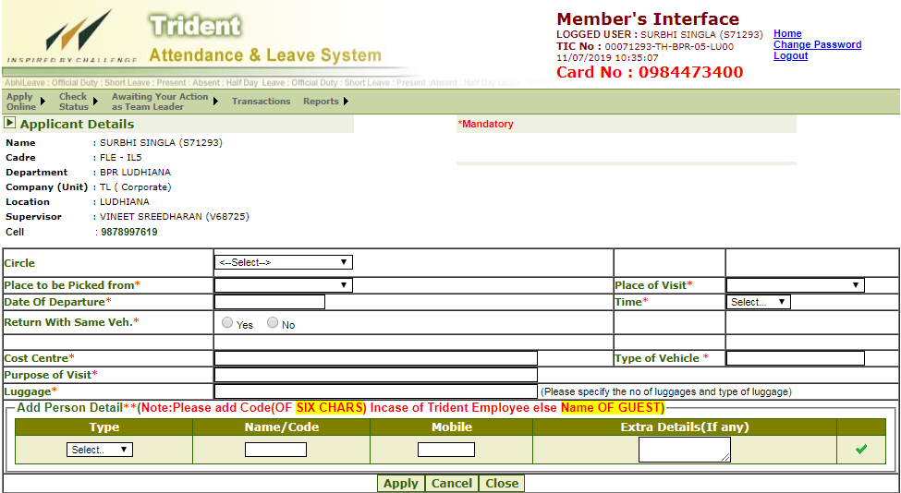
Existing Interface

Slide 14
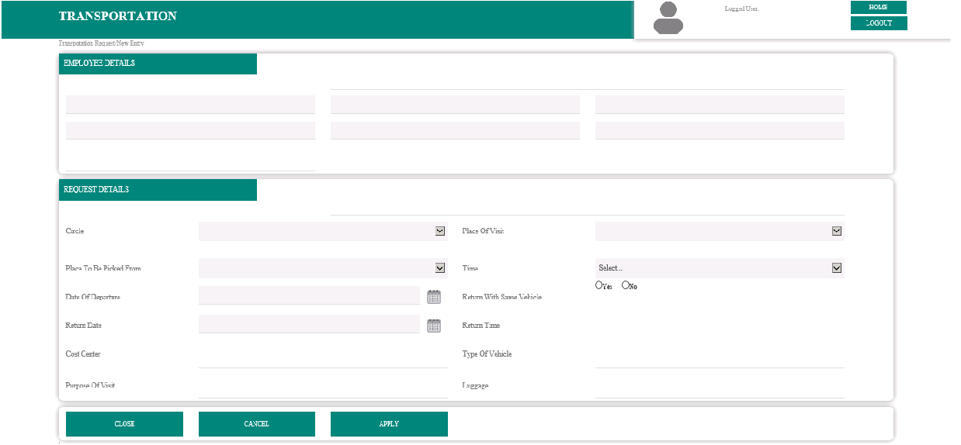
New Interface

Slide 15
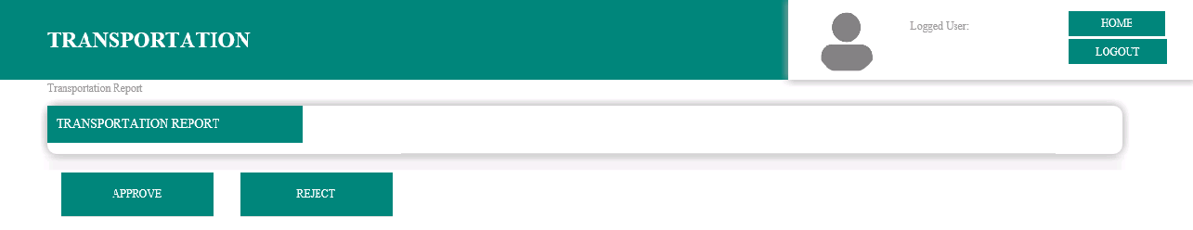
Request For Transportation
After supervisor’s approval, this newly designed page opens on the admin’s end.
Multiple Selection - Using checkbox multiple request can be processed to reduce the work load of the admin team.

Slide 16
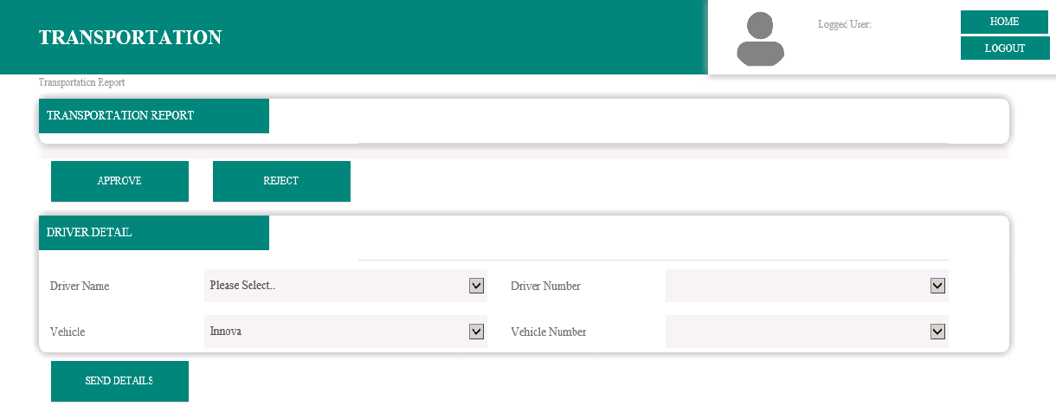
NEWLY DESIGNED ADMIN PAGE
Driver Details – Helps in selecting details quickly with auto filled fields.

Slide 17
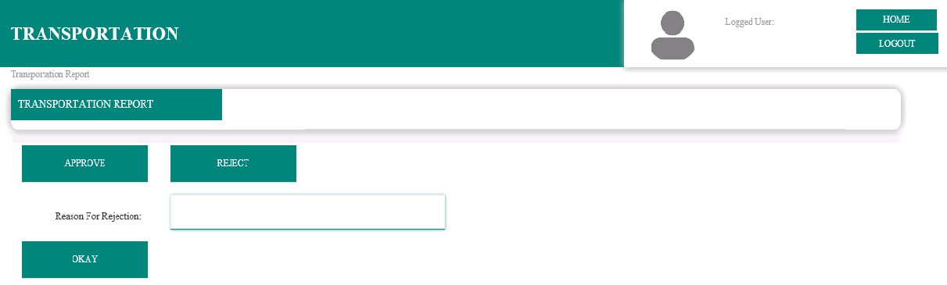
NEWLY DESIGNED ADMIN PAGE
New Pop Up – Field for mentioning the reason upon the denial of the request.

Slide 18
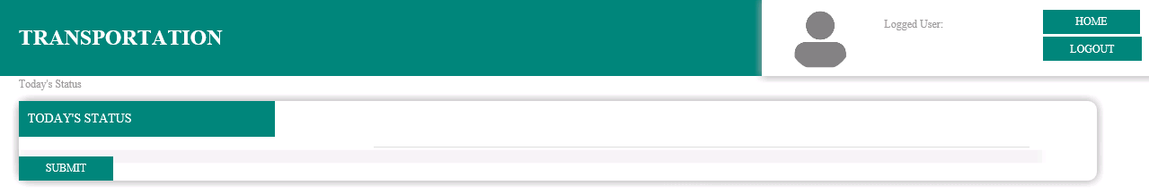
Additional Features – Today’s Status
Today’s Status : Security can update about the employee’s presence as per the request.

Slide 19
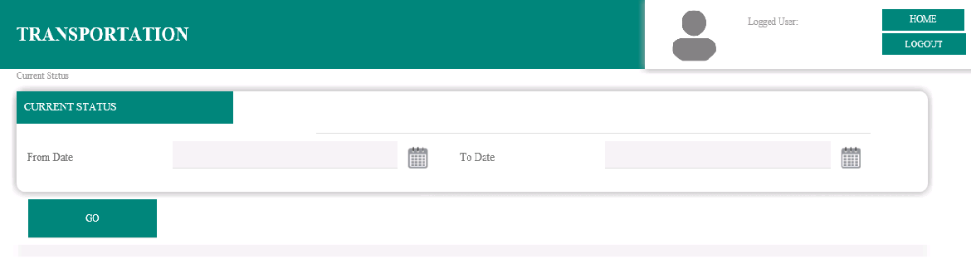
Additional Features – Current Status
Current Status : User can check the request status

Slide 20
Applications
Application 2: Condition Record Update

Slide 21
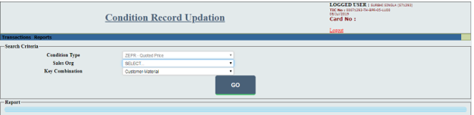
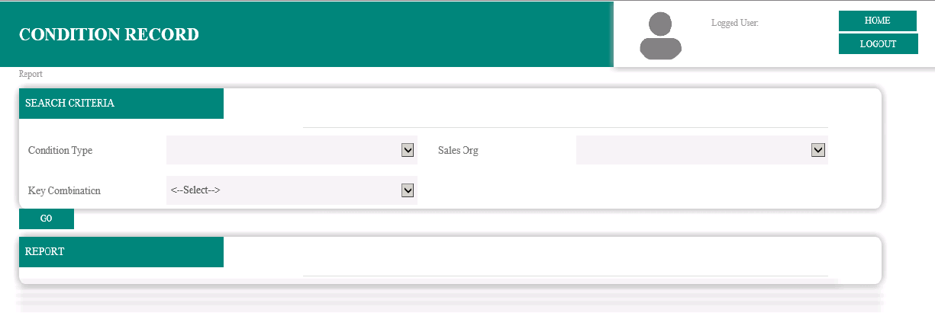
Redesigned Condition Record Update
Existing Interface
New Interface

Slide 22
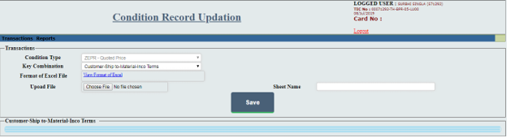
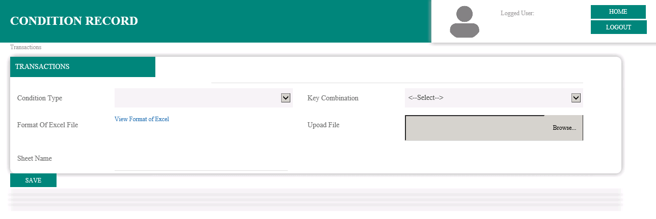
Redesigned Condition Record Update
Existing Interface
New Interface

Slide 23
Applications
Application 3: Trident Letter Entry System

Slide 24
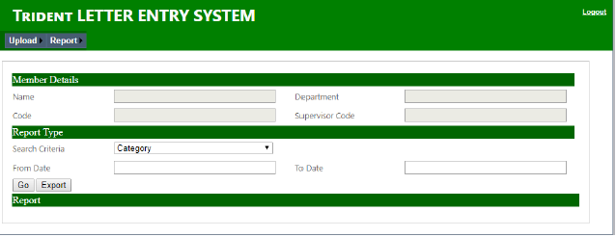
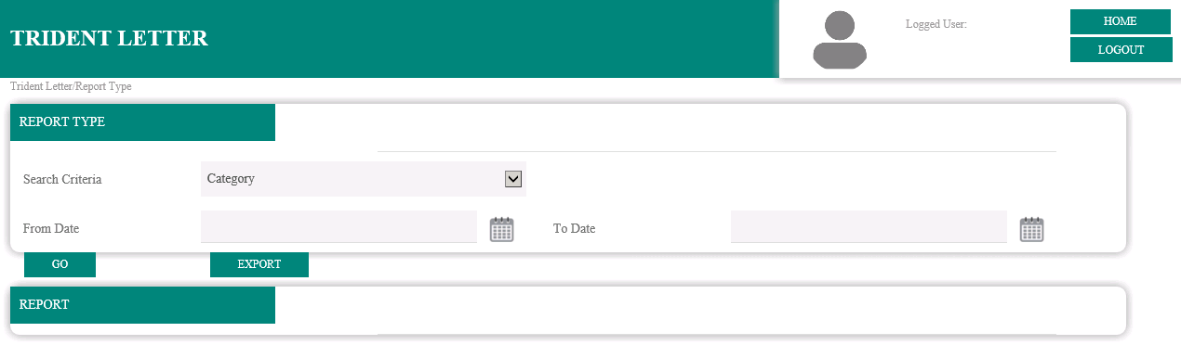
Redesigned Trident Letter
Page 1/4
Existing Interface
New Interface

Slide 25
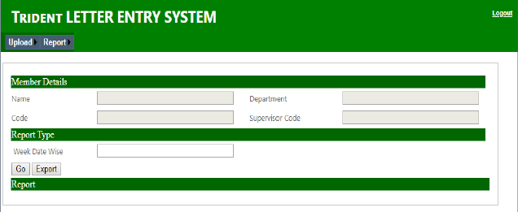
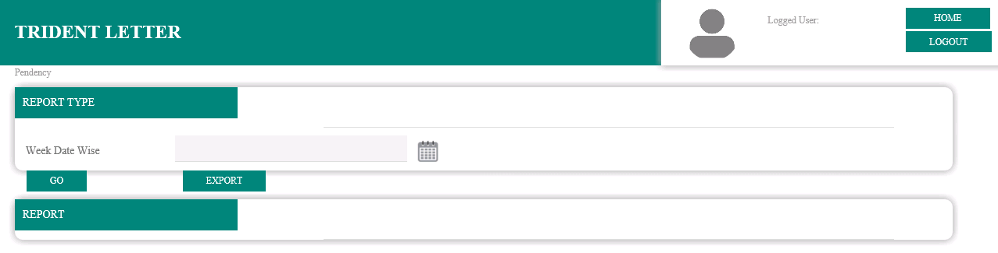
Redesigned Trident Letter
Page 2/4
Existing Interface
New Interface

Slide 26
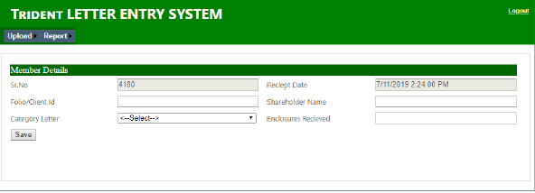
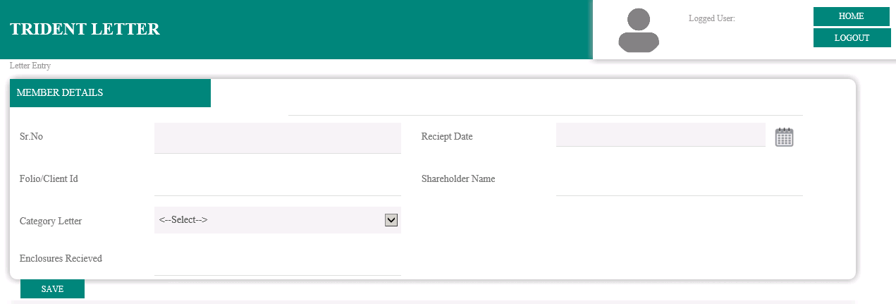
Redesigned Trident Letter
Page 3/4
Existing Interface
New Interface

Slide 27
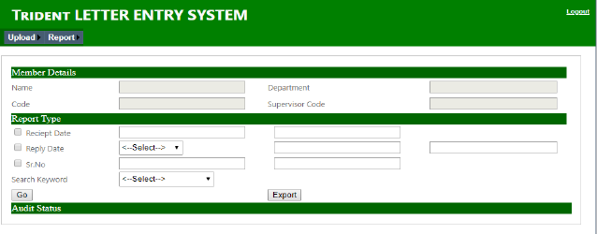
Redesigned Trident Letter
Page 4/4
Existing Interface

Slide 28
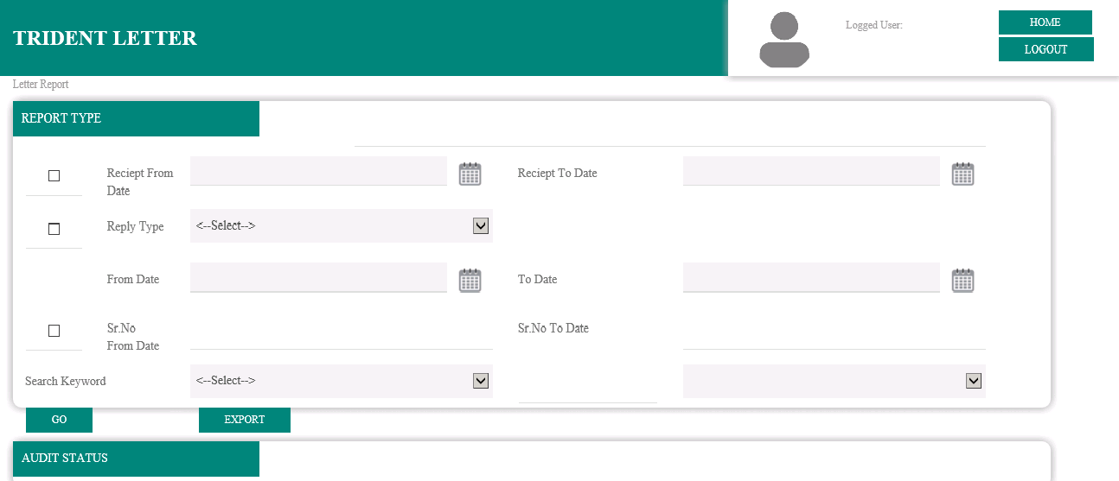
Redesigned Trident Letter
Page 4/4
New Interface

Slide 29
Key Learnings and Takeaways
Handling Microsoft Visual Studio
ASP.NET 4.0 Framework
Improved skill set-in front-end development: HTML/CSS
Learnt basics in bootstrap :-
  Dividing web page into columns and making it optimum for different screen sizes
Learn new features of web development:-
  Disabling and enabling fields or section of page on click of a button.
Linking Front End and Back End of Websites
Adapting to new work environment
People management
Time Management at work
Setting up proper Routine

Slide 30
THANK YOU

